Slide 1
Entity-Relationship (ER) Model

Slide 2
Database Design
Requirements collection and analysis
  Database designers interview database users to understand and document their data requirements.
  Result of this step is a concisely written set of users’ requirements.
Once the requirements have been collected and analyzed, the next step is to create a conceptual schema for the database, using a high-level conceptual data model. This step is called conceptual design.
Conceptual schema is a concise description of the data requirements of the users and includes detailed descriptions of the entity types, relationships, and constraints; these are expressed using the concepts provided by the high-level data model.

Slide 3
Example COMPANY Database
We need to create a database schema design based on the following requirements of the COMPANY Database:
  The company is organized into DEPARTMENTs. Each department has a name, number and an employee who manages the department. We keep track of the start date of the department manager. A department may have several locations.
  Each department controls a number of PROJECTs. Each project has a unique name, unique number and is located at a single location.

Slide 4
Example COMPANY Database
  The database will store each EMPLOYEE’s social security number, address, salary, gender, and birthdate.
    Each employee works for one department but may work on several projects, which are not necessarily controlled by the same department.
    The DB will keep track of the number of hours per week that an employee currently works on each project.
    It is required to keep track of the direct supervisor of each employee (who is another employee).
  Each employee may have a number of DEPENDENTs (for insurance purposes)
    For each dependent, the DB keeps a record of name, gender, birthdate, and relationship to the employee.

Slide 5
Entities and Attributes
The basic object that the ER model represents is an entity, which is a thing in the real world with an independent existence. An entity may be an object with a physical existence (for example, a particular person, car, house, or employee) or it may be an object with a conceptual existence (for instance, a company, a job, or a university course).
  For example the EMPLOYEE John Smith, the Research DEPARTMENT, the ProductX PROJECT
Each entity has attributes. Attributes are properties used to describe an entity.
  For example an EMPLOYEE entity may have the attributes Name, SSN, Address, Gender, BirthDate
A specific entity will have a value for each of its attributes.
  For example a specific employee entity may have Name='John Smith', SSN='123456789', Address ='731, Fondren, Houston, TX’, Gender='M', BirthDate='09-JAN-55‘
Each attribute has a value set (or data type) associated with it – e.g. integer, string, date, enumerated type, …

Slide 6
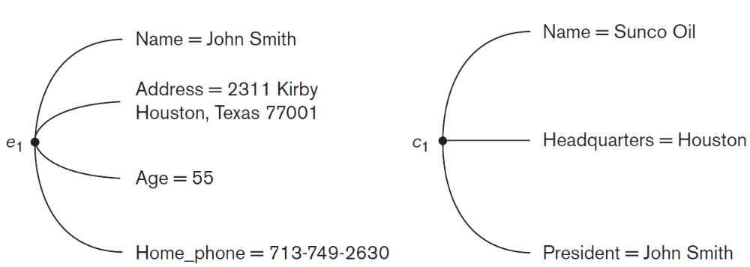
Entities and Attributes
Two entities, EMPLOYEE e₁, and COMPANY c₁, and their attributes

Slide 7
Types of Attributes
Simple
  Attributes that are not divisible are called simple or atomic attributes. Each entity has a single atomic value for the attribute. For example, SSN or Gender.
Composite
  The attribute may be composed of several components. Composite attributes can be divided into smaller subparts, which represent more basic attributes with independent meanings. For example:
    Address (Street_address, City, State, Zip)
    Name (FirstName, MiddleName, LastName)
  Composition may form a hierarchy where some components are themselves composite.

Slide 8
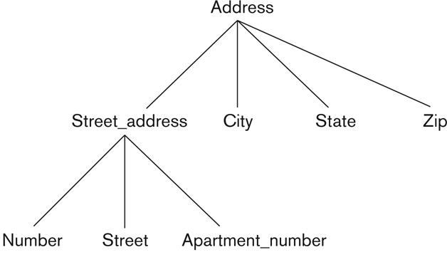
A hierarchy of composite attributes

Slide 9
Types of Attributes
Single-Valued
  Attributes that have a single value for a particular entity. For example, Age is a single-valued attribute of a person.
Multi-valued
  An attribute can have a set of values or multiple values for the same entity.
  For example, Phone_number attribute for an employee, or a Degree attribute for a person.
  Denoted as {Phone_number} or {Degrees}

Slide 10
Types of Attributes
Stored
  Attribute which already stored in database. For example, Birth_date attribute of a person.
Derived
  Derivable from stored attribute. For example, Age attribute of a person. Age attribute is derivable from the Birth_date attribute, which is a stored attribute.

Slide 11
NULL Values
Not applicable: In some cases, a particular entity may not have an applicable value for an attribute. For example,
  Apartment_number attribute of an address applies only to addresses that are in apartment buildings and not to other types of residences, such as single-family homes.
  College_degrees attribute applies only to people with college degrees.
For such situations, a special value called NULL is created. An address of a single-family home would have NULL for its Apartment_number attribute, and a person with no college degree would have NULL for College_degrees.
Unknown: NULL can also be used if we do not know the value of an attribute for a particular entity. For example, if we do not know the home phone number of an employee.

Slide 12
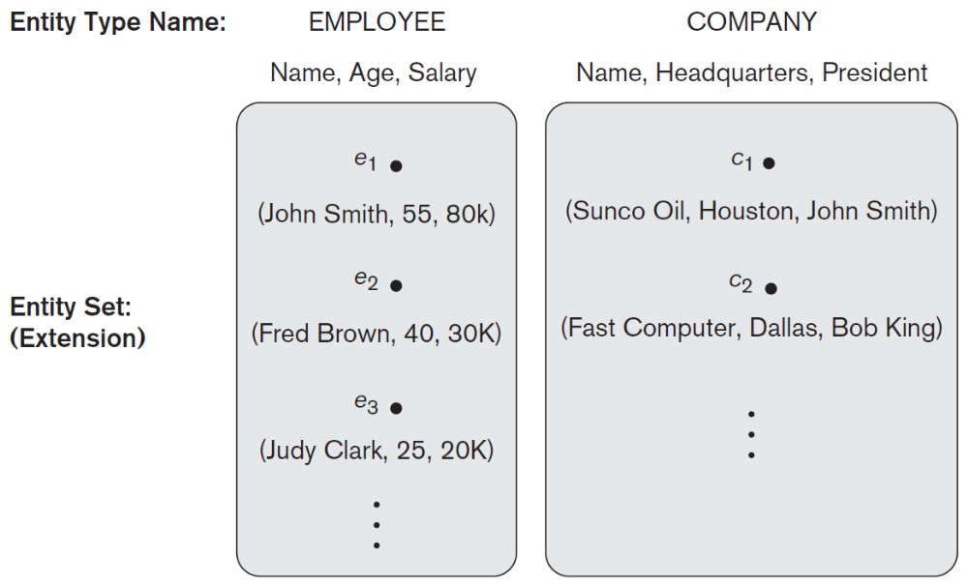
Entity Types and Entity Sets
An entity type defines a collection (or set) of entities that have the same attributes. Entities with the same basic attributes are grouped or typed into an entity type.
Each entity type in the database is described by its name and attributes.

Slide 13
Entity Types and Entity Sets
Each entity type will have a collection of entities stored in the database.
The collection of all entities of a particular entity type in the database at any point in time is called an entity set. Entity set is the current state of the entities of that type that are stored in the database.
Entity set is usually referred to using the same name as the entity type. For example, EMPLOYEE refers to both a type of entity as well as the current set of all employee entities in the database.
An entity type is represented in ER diagram as a rectangular box enclosing the entity type name.
Attribute names are enclosed in ovals and are attached to their entity type by straight lines.
Composite attributes are attached to their component attributes by straight lines.
Multivalued attributes are displayed in double ovals.
An entity type describes the schema or intension for a set of entities that share the same structure. The collection of entities of a particular entity type is grouped into an entity set, which is also called the extension of the entity type.

Slide 14
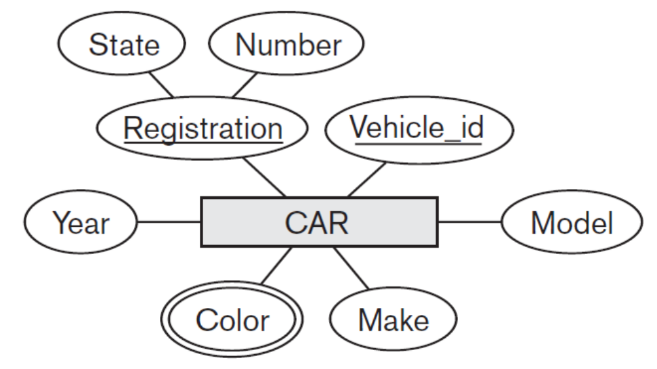
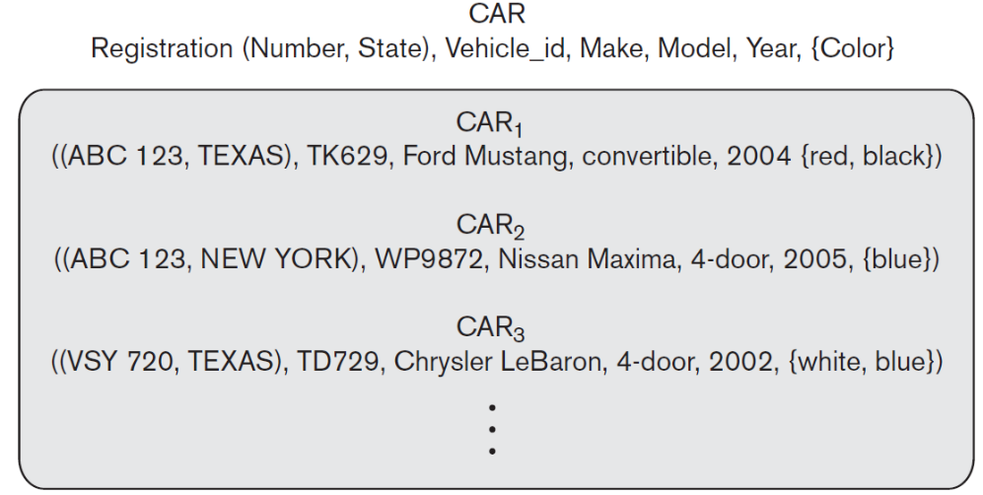
Example: CAR Entity Type
ER diagram notation:
Entity set with three entities:

Slide 15
Key Attributes of an Entity Type
An entity type usually has one or more attributes whose values are distinct for each individual entity in the entity set. Such an attribute is called a key attribute, and its values can be used to identify each entity uniquely.
An attribute of an entity type for which each entity must have a unique value is called a key attribute of the entity type.
For example
  Name attribute is a key of the COMPANY entity type because no two companies are allowed to have the same name.
  SSN (Social Security number) of EMPLOYEE
A key attribute may be composite.
  VehicleRegistrationNumber is a key of the CAR entity type with components (Number, State).

Slide 16
Key Attributes of an Entity Type
An entity type may have more than one key. For example, each of the Vehicle_id and Registration attributes of the entity type CAR is a key.
An entity type may also have no key, in which case it is called a weak entity type.
In ER diagrammatic notation, each key attribute has its name underlined inside the oval.

Slide 17
Initial Conceptual Design of Entity Types for the COMPANY Database Schema
Based on the requirements, we can identify four initial entity types in the COMPANY database:
  DEPARTMENT
  PROJECT
  EMPLOYEE
  DEPENDENT

Slide 18
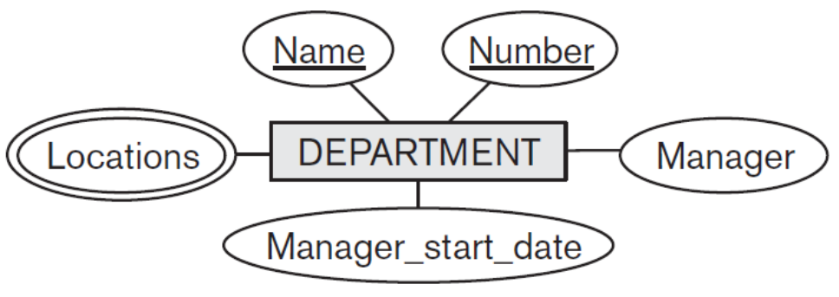
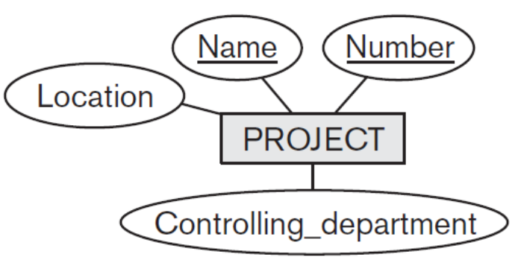
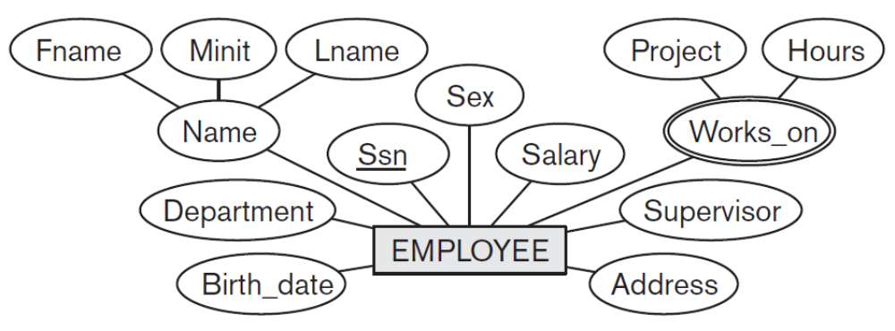
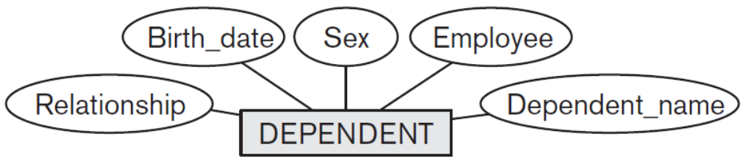
Initial Design of Entity Types:
EMPLOYEE, DEPARTMENT, PROJECT, DEPENDENT

Slide 19
Refining the initial design by introducing relationships
The initial design is typically not complete.
Some aspects in the requirements will be represented as relationships.
ER model has three main concepts:
  Entities (and their entity types and entity sets)
  Attributes (simple, composite, multivalued)
  Relationships (and their relationship types and relationship sets)
We introduce relationship concepts.

Slide 20
Relationships
There are several implicit relationships among the various entity types.
Whenever an attribute of one entity type refers to another entity type, some relationship exists. For example,
  Attribute Manager of DEPARTMENT refers to an employee who manages the department.
  Attribute Controlling_department of PROJECT refers to the department that controls the project.
  Attribute Supervisor of EMPLOYEE refers to another employee.
  Attribute Department of EMPLOYEE refers to the department for which the employee works.
In the initial design of entity types, relationships are typically captured in the form of attributes. As the design is refined, these attributes get converted into relationships between entity types.

Slide 21
Relationship Types, Sets, and Instances
A relationship relates two or more distinct entities with a specific meaning.
  For example, EMPLOYEE Rama works on the ProductX PROJECT, or EMPLOYEE Krishna manages the Research DEPARTMENT.
Relationships of the same type are grouped or typed into a relationship type.
  For example, the WORKS_ON relationship type in which EMPLOYEEs and PROJECTs participate, or the MANAGES relationship type in which EMPLOYEEs and DEPARTMENTs participate.
A relationship type R among n entity types E₁, E₂, ..., E_{n} defines a set of associations—or a relationship set—among entities from these entity types.

Slide 22
Relationship Types, Sets, and Instances
Mathematically, the relationship set R is a set of relationship instances r_{i}, where each r_{i} associates n individual entities (e₁, e₂, ..., e_{n}), and each entity e_{j} in r_{i} is a member of entity set E_{j}, 1 ≤ j ≤n.
A relationship set is a mathematical relation on E₁, E₂, ... , E_{n}
It can be defined as a subset of the Cartesian product of the entity sets E₁ × E₂ × ... × E_{n}.
Each of the entity types E₁, E₂,..., E_{n} is said to participate in the relationship type R.
Each of the individual entities e₁, e₂, ..., e_{n} is said to participate in the relationship instance r_{i} = (e₁, e₂, ..., e_{n})

Slide 23
Relationship instances of the WORKS_FOR N:1 relationship between EMPLOYEE and DEPARTMENT
Consider a relationship type WORKS_FOR between the two entity types EMPLOYEE and DEPARTMENT, which associates each employee with the department for which the employee works in the corresponding entity set.
Each relationship instance in the relationship set WORKS_FOR associates one EMPLOYEE entity and one DEPARTMENT entity.

Slide 24
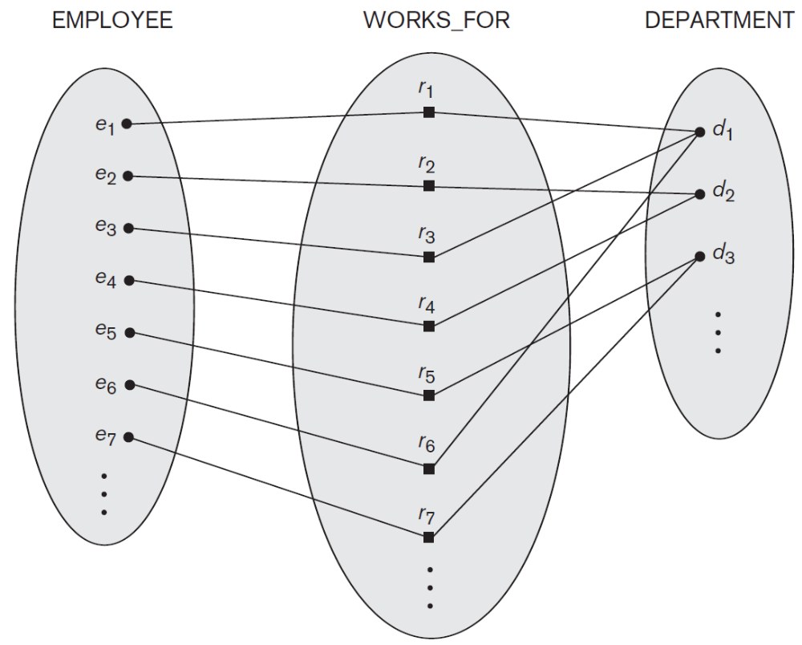
Relationship instances of the WORKS_FOR N:1 relationship between EMPLOYEE and DEPARTMENT

Slide 25
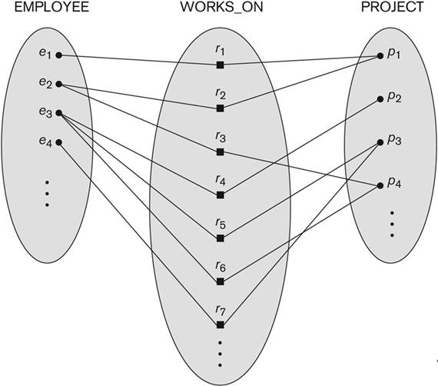
Relationship instances of the M:N WORKS_ON relationship between EMPLOYEE and PROJECT

Slide 26
Relationship type vs. relationship set
Relationship Type:
  Is the schema description of a relationship
  Identifies the relationship name and the participating entity types
  Also identifies certain relationship constraints
Relationship Set:
  The current set of relationship instances represented in the database
  The current state of a relationship type
Each instance in the relationship set relates individual participating entities – one from each participating entity type.
In ER diagrams, we represent the relationship type as follows:
  Diamond-shaped box is used to display a relationship type
  Connected to the participating entity types via straight lines

Slide 27
Degree of a Relationship Type
The degree of a relationship type is the number of participating entity types.
WORKS_FOR relationship is of degree two.
A relationship type of degree two is called binary, and one of degree three is called ternary.

Slide 28
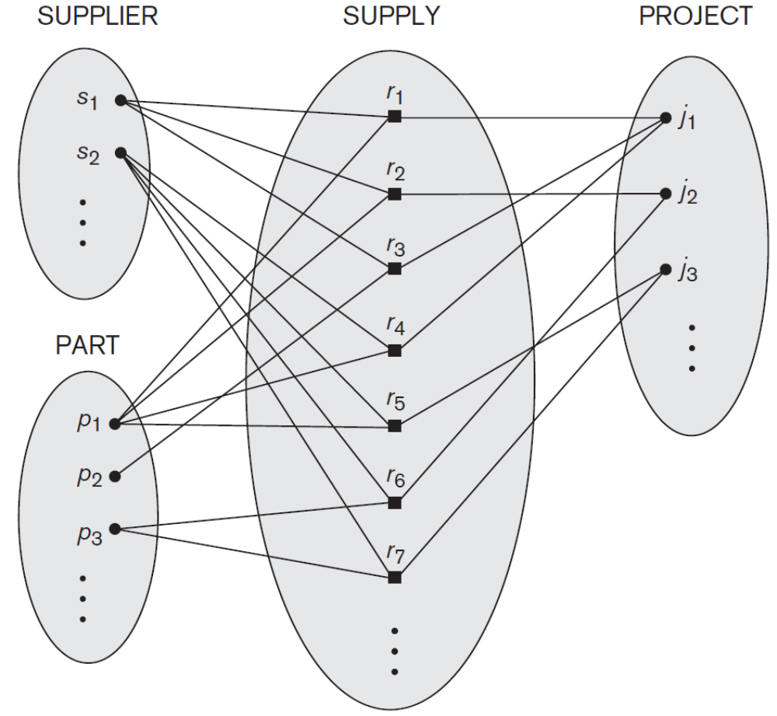
Example of ternary relationship
Each relationship instance r_{i} associates three entities—a supplier s, a part p, and a project j—whenever s supplies part p to project j.

Slide 29
Recursive Relationship Type
In some cases the same entity type participates more than once in a relationship type in different roles.
A relationship type between the same participating entity type in distinct roles.
Also called self-referencing relationship type.
Example: SUPERVISION relationship type relates an employee to a supervisor, where both employee and supervisor entities are members of the same EMPLOYEE entity set.
EMPLOYEE participates twice in two distinct roles:
  supervisor role
  supervisee (or subordinate) role
Each relationship instance relates two distinct EMPLOYEE entities:
  One employee in supervisor role
  One employee in supervisee role
In ER diagram, need to display role names to distinguish participations.

Slide 30
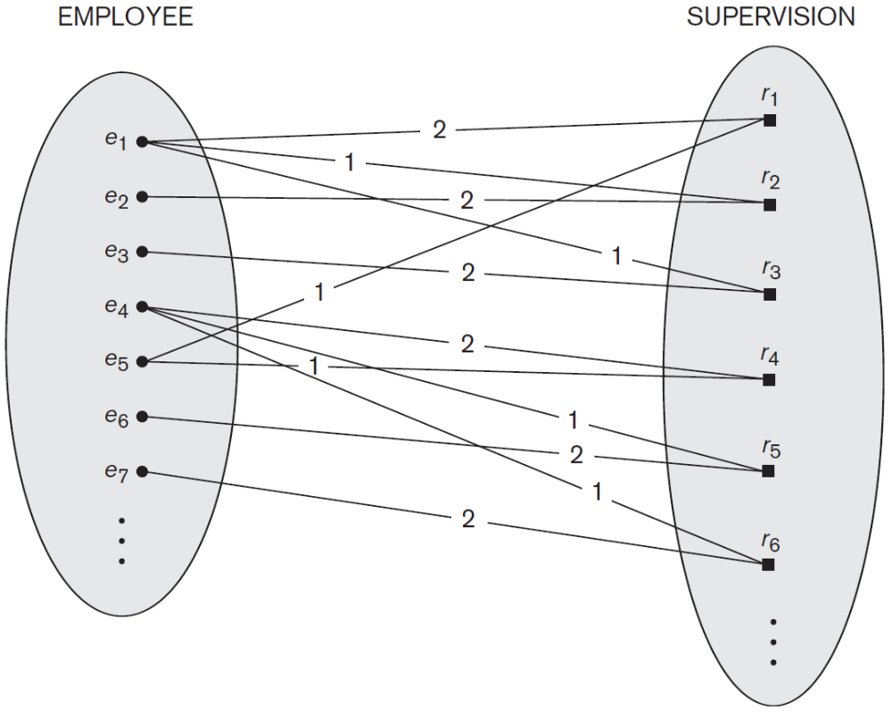
A Recursive Relationship Supervision
Lines marked ‘1’ represent the supervisor role, and those marked ‘2’ represent the supervisee role.
e₁ supervises e₂ and e₃, e₄ supervises e₆ and e₇, and e₅ supervises e₁ and e₄
Each relationship instance must be connected with two lines, one marked with ‘1’ (supervisor) and the other with ‘2’ (supervisee).

Slide 31
Constraints on Binary Relationship Types
Relationship types usually have certain constraints that limit the possible combinations of entities that may participate in the corresponding relationship set.
The cardinality ratio for a binary relationship specifies the maximum number of relationship instances that an entity can participate in.
For example, in the WORKS_FOR binary relationship type, DEPARTMENT:EMPLOYEE is of cardinality ratio 1:N, meaning that each department can be related to (that is, employs) any number of employees, but an employee can be related to (work for) only one department.
For this particular relationship WORKS_FOR, a particular department entity can be related to any number of employees (N indicates there is no maximum number).
On the other hand, an employee can be related to a maximum of one department.

Slide 32
Cardinality ratios
Cardinality Ratio (specifies maximum participation)
  One-to-one (1:1)
  One-to-many (1:N)
  Many-to-one (N:1)
  Many-to-many (M:N)
Cardinality ratios for binary relationships are represented on ER diagrams by displaying 1, M, and N on the diamonds.
We can either specify no maximum (N) or a maximum of one (1) on participation.

Slide 33
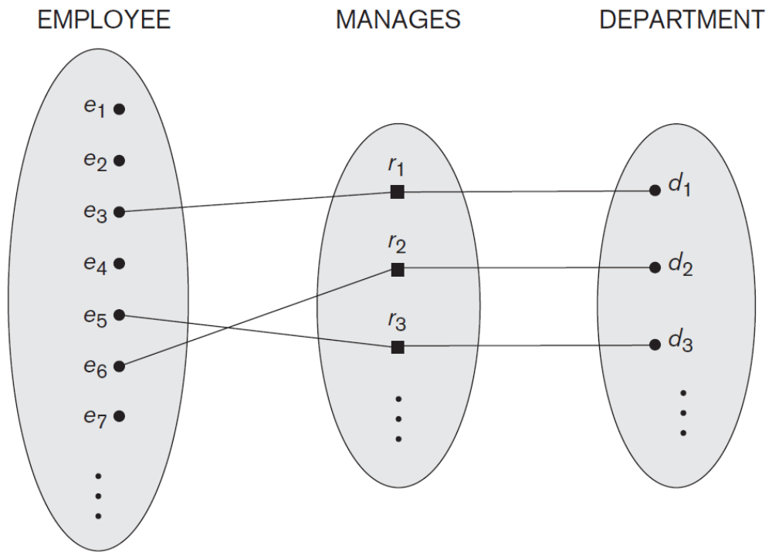
One-to-one (1:1) Relationship
An employee can manage one department only and a department can have one manager only.

Slide 34
Many-to-one (N:1) Relationship

Slide 35
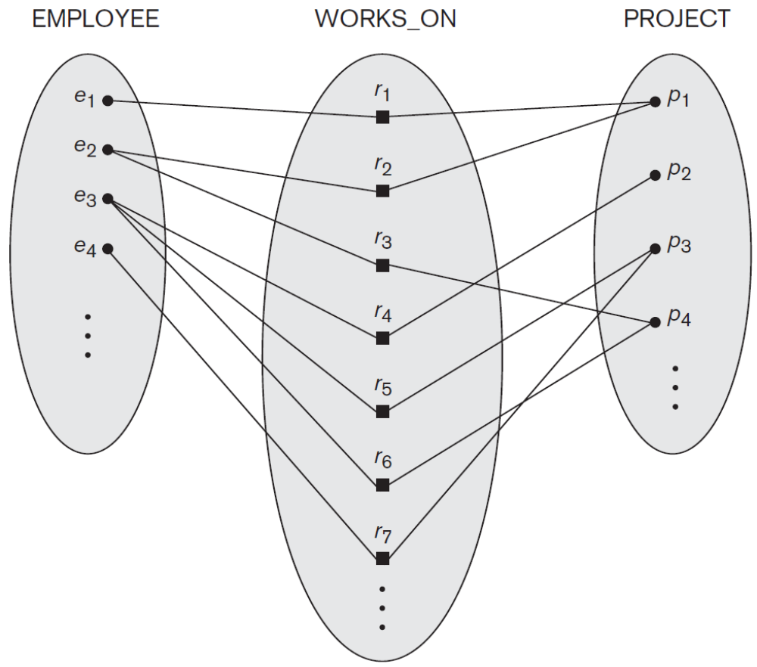
Many-to-many (M:N) Relationship
An employee can work on several projects and a project can have several employees.

Slide 36
MCQs
1. An ________ is a set of entities of the same type that share the same properties, or attributes.
a) Entity set b) Attribute set
c) Relation set d) Entity model
2. Entity is a _________
a) Object of relation b) Present working model
c) Thing in real world d) Model of relation
3. The descriptive property possessed by each entity set is _________
a) Entity b) Attribute
c) Relation d) Model

Slide 37
MCQs
4. The function that an entity plays in a relationship is called that entity’s _____________
a) Participation b) Position
c) Role d) Instance
5. The attribute name could be structured as an attribute consisting of first name, middle initial, and last name. This type of attribute is called
a) Simple attribute b) Composite attribute
c) Multivalued attribute d) Derived attribute
6. The attribute AGE is calculated from DATE_OF_BIRTH. The attribute AGE is
a) Single valued b) Multi valued
c) Composite d) Derived

Slide 38
MCQs
7. Not applicable condition can be represented in relation entry as
a) NA b) 0
c) NULL d) Blank Space
8. Which of the following can be a multivalued attribute?
a) Phone_number b) Name
c) Date_of_birth d) All of the mentioned
9. Which of the following is a single valued attribute
a) Register_number b) Address
c) SUBJECT_TAKEN d) Reference

Slide 39
1.
A.
Minimum cardinality
B.
Maximum cardinality
C.
ERD
D.
Greater Entity Count (GEC)
2.
A.
Weak entity
B.
Strong entity
C.
ID-dependent entity
D.
ID- independent entity

Slide 40
Participation Constraints and Existence Dependencies
The participation constraint specifies whether the existence of an entity depends on another entity via the relationship type.
This constraint specifies the minimum number of relationship instances that each entity can participate in, and is called the minimum cardinality constraint.
Two types of participation constraints
  Total
  Partial
If a company policy states that every employee must work for a department, then an employee entity can exist only if it participates in at least one WORKS_FOR relationship instance.
Notes:
In a Relationship, Participation constraint specifies the presence of an entity when it is related to another entity in a relationship type. It is also called the minimum cardinality constraint.
This constraint specifies the number of instances of an entity that are participating in the relationship type.

Slide 41
Participation Constraints and Existence Dependencies
Participation of EMPLOYEE in WORKS_FOR is called total participation, meaning that every entity in the total set of employee entities must be related to a department entity via WORKS_FOR.
Total participation is also called existence dependency.
We do not expect every employee to manage a department, so the participation of EMPLOYEE in the MANAGES relationship type is partial, meaning that some or part of the set of employee entities are related to some department entity via MANAGES, but not necessarily all.

Slide 42
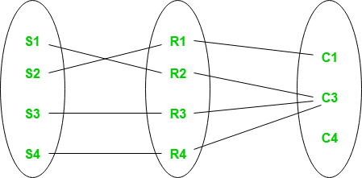
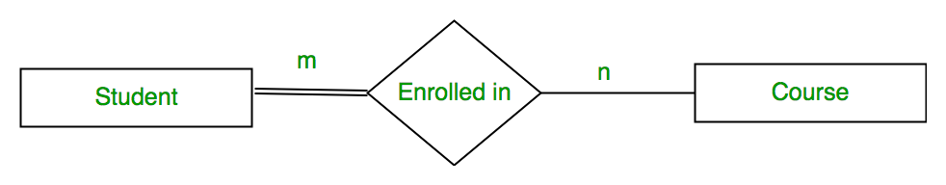
Participation Constraints and Existence Dependencies
In ER diagram,
  Total participation (or existence dependency) is displayed as a double line connecting the participating entity type to the relationship.
  Partial participation is represented by a single line.

Slide 43
Attributes of Relationship Types
A Relationship type can have attributes.
For example
  To record the number of hours per week that an employee works on a particular project, we can include an attribute Hours for the WORKS_ON relationship type.
    A value of Hours depends on a particular (employee, project) combination.
  To include the date on which a manager started managing a department via an attribute Start_date for the MANAGES relationship type.
Most relationship attributes are used with M:N relationships.

Slide 44
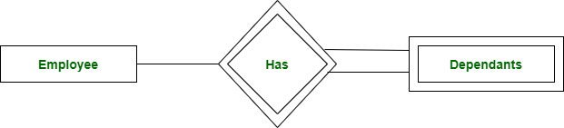
Weak Entity Types
An entity type that does not have a key attribute of its own and and that is identification-dependent on another entity type.
Regular entity types that do have a key attribute are called strong entity types.
Entities belonging to a weak entity type are identified by being related to specific entities from another entity type in combination with one of their attribute values.
We call this other entity type the identifying or owner entity type of the weak entity type.
We call the relationship type that relates a weak entity type to its owner the identifying relationship of the weak entity type.
A weak entity must participate in n identifying relationship type with an owner or identifying entity type.
Notes:
For example, A company may store the information of dependents (Parents, Children, Spouse) of an Employee. But the dependents don’t have existence without the employee. So Dependent will be weak entity type and Employee will be Identifying Entity type for Dependent.

Slide 45
Weak Entity Types
A weak entity type always has a total participation constraint (existence dependency) with respect to its identifying relationship because a weak entity cannot be identified without an owner entity.
For example, a DRIVER_LICENSE entity cannot exist unless it is related to a PERSON entity, even though it has its own key (License_number) and hence is not a weak entity.
A weak entity type has a partial key, which is the attribute that can uniquely identify weak entities that are related to the same owner entity.
The set of attributes that are used to uniquely identify a weak entity set is called the Partial key. Only a bunch of the tuples can be identified using the partial keys. The partial Key of the weak entity set is also known as a discriminator.
In the worst case, a composite attribute of all the weak entity’s attributes will be the partial key.
Notes:
The set of attributes that are used to uniquely identify a weak entity set is called the Partial key. Only a bunch of the tuples can be identified using the partial keys. The partial Key of the weak entity set is also known as a discriminator.

Slide 46
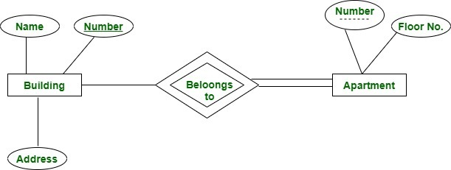
Notes:
Here we have an apartment as a weak entity and building as a strong entity type connected via ‘belongs to’ relationship set. Apartment number is not globally unique i.e. more than one apartment may have same number globally but it is unique for a particular building since a building may not have same apartment number. Thus apartment number cannot be primary key of entity Apartment but it is a partial key shown with a dashed line.

Slide 47
Weak Entity Types
Example:
  A DEPENDENT entity is identified by the dependent’s name, and the specific EMPLOYEE with whom the dependent is related.
  Name of DEPENDENT is the partial key
  DEPENDENT is a weak entity type
  EMPLOYEE is its identifying entity type via the identifying relationship type DEPENDENT_OF
In ER diagram
  Both a weak entity type and its identifying relationship are distinguished by surrounding their boxes and diamonds with double lines.
  The partial key attribute is underlined with a dashed or dotted line.
A weak entity type may have more than one identifying entity type and an identifying relationship type of degree higher than two.

Slide 48
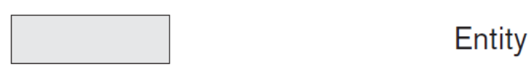



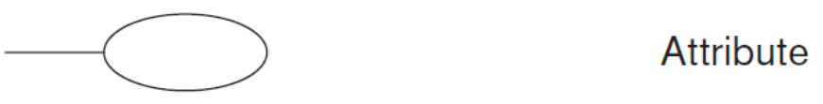
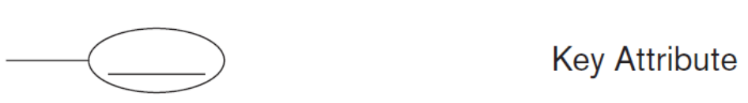
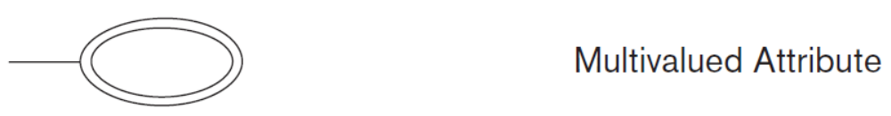
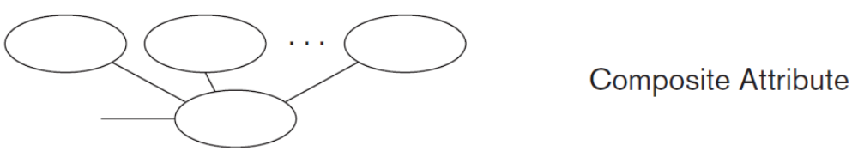
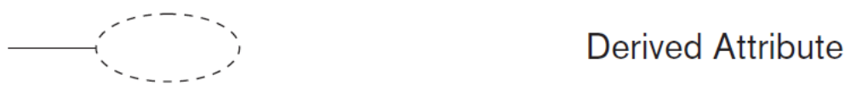
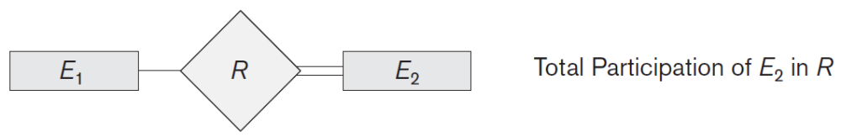
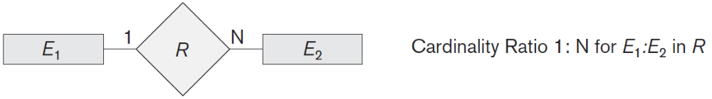
Notation for ER Diagrams

Slide 49
Refining the COMPANY database schema by introducing relationships
By examining the requirements, six relationship types are identified
All are binary relationships (degree 2)
Listed below with their participating entity types:
  WORKS_FOR (between EMPLOYEE, DEPARTMENT)
  MANAGES (also between EMPLOYEE, DEPARTMENT)
  CONTROLS (between DEPARTMENT, PROJECT)
  WORKS_ON (between EMPLOYEE, PROJECT)
  SUPERVISION (between EMPLOYEE (as subordinate), EMPLOYEE (as supervisor))
  DEPENDENTS_OF (between EMPLOYEE, DEPENDENT)

Slide 50
Discussion on Relationship Types
In the refined design, some attributes from the initial entity types are refined into relationships:
  Manager of DEPARTMENT -> MANAGES
  Works_on of EMPLOYEE -> WORKS_ON
  Department of EMPLOYEE -> WORKS_FOR
  etc
In general, more than one relationship type can exist between the same participating entity types
  MANAGES and WORKS_FOR are distinct relationship types between EMPLOYEE and DEPARTMENT
  Different meanings and different relationship instances.

Slide 51
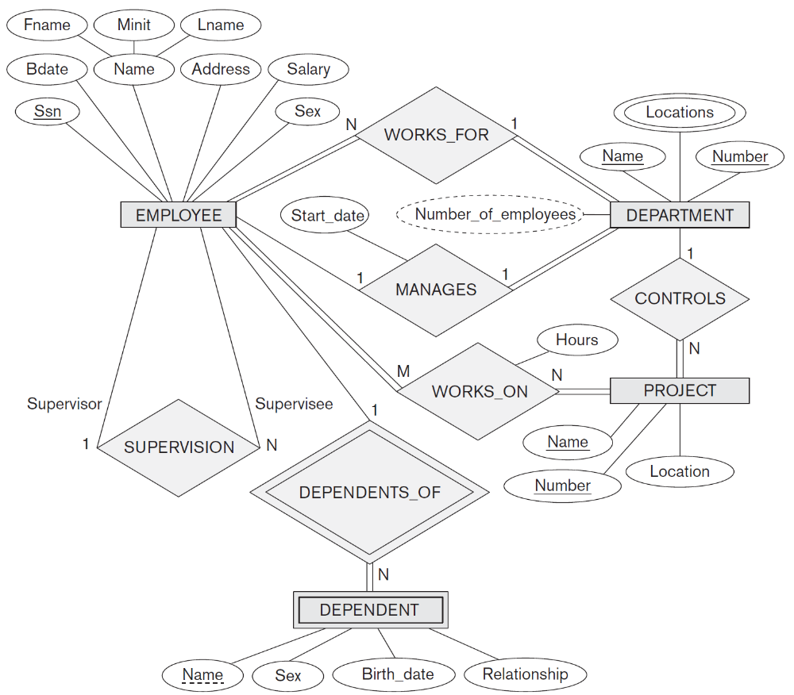
ER diagram for COMPANY database

Slide 52
Relationships of Higher Degree
Relationship types of degree 2 are called binary.
Relationship types of degree 3 are called ternary and of degree n are called n-ary.
In general, an n-ary relationship is not equivalent to n binary relationships.
Constraints are harder to specify for higher-degree relationships (n > 2) than for binary relationships.
In general, a relationship type R of degree n will have n edges in an ER diagram, one connecting R to each participating entity type.

Slide 53
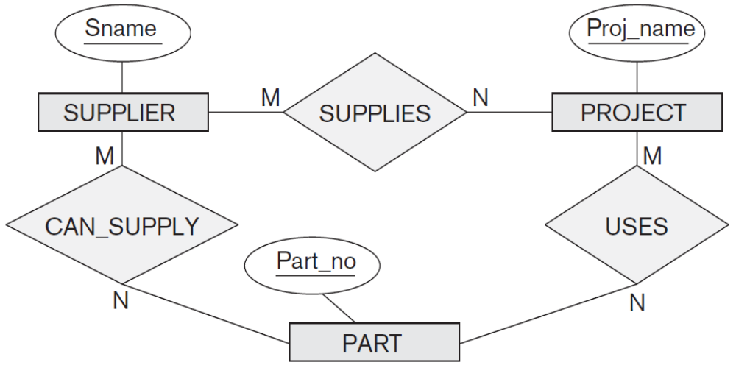
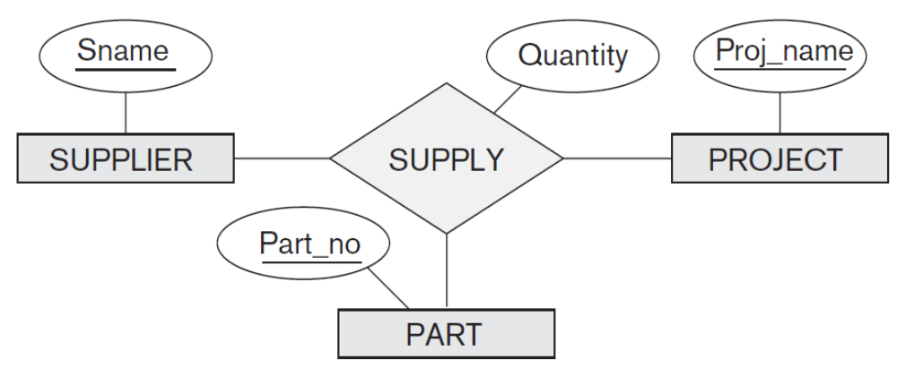
Relationships of Higher Degree
In general, 3 binary relationships can represent different information than a single ternary relationship.
Existence of three relationship instances (s, p), ( j, p), and (s, j) in CAN_SUPPLY, USES, and SUPPLIES, respectively, does not necessarily imply that an instance (s, j, p) exists in the ternary relationship SUPPLY, because the meaning is different.

Slide 54
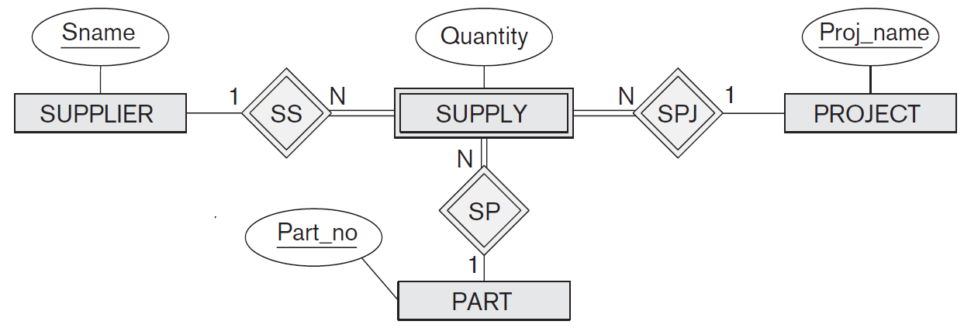
Relationships of Higher Degree
In some cases, a ternary relationship can be represented as a weak entity.
Then a weak entity type have multiple identifying relationships (and hence multiple owner entity types).
SUPPLY is represented as a weak entity type, with no partial key and with three identifying relationships.

Slide 55
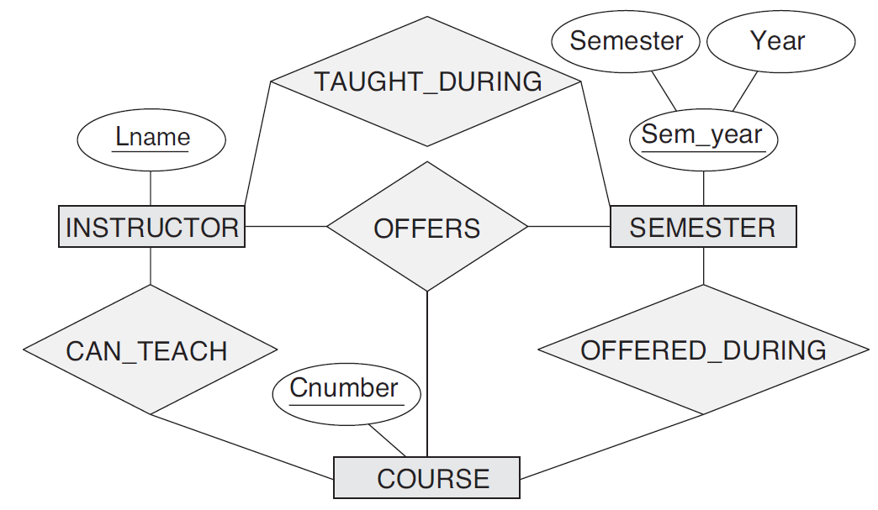
Relationships of Higher Degree
If a particular binary relationship can be derived from a higher-degree relationship at all times, then it is redundant.
TAUGHT_DURING binary relationship can be derived from the ternary relationship OFFERS.

Slide 56
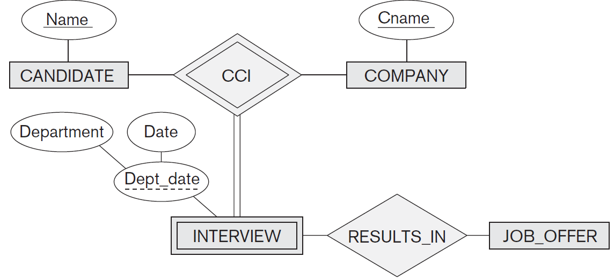
Weak entity type with a ternary (or n-ary) identifying relationship type
Part of a database that keeps track of candidates interviewing for jobs at various companies.
INTERVIEW entity is uniquely identified by a candidate, a company, and the combination of the date and department of the interview.

